Slide 1

How Children Feel Pain
Pediatric Pain PRN Curriculum
Notes:
Materials: Flip chart or whiteboard and Markers
Provide participant guide at least one week in advance
Room setup in tables of 4 or 6-8 depending on number of participants
Display slide as participants walk in
This session is 30 minutes
Welcome & Introductions: Introduce facilitator if necessary
READ: The learning objectives for this content are to:
Describe theories that inform our understanding of pain
Explain the biopsychosocial model of pain
Many factors influence the perception of pain. Pain is not simply a physiologic experience
In this learning activity, we will explore some of the factors that influence pain perception.
The PRN curriculum is based on the biopsychosocial model, treating the whole person with pain.
© 2017 Manworren & Lurie Children’s Hospital
All rights reserved. Version 2019 1

Slide 2

How do you KNOW your experience is pain?
Notes:
ASK: How do you know your experience is pain?
Select participants willing to share their answer to this question.
Write on flipchart or whiteboard
[Limit discussion to 5 minutes]
READ these Key points (if not included by participants):
Descartes suggests there are strings of neurons from the site of pain to the brain
There are other theories and models that you may have used to explain pain and how pain treatments work
© 2017 Manworren & Lurie Children’s Hospital
All rights reserved. Version 2019

Slide 3
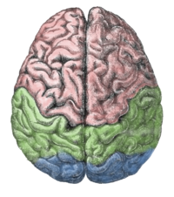
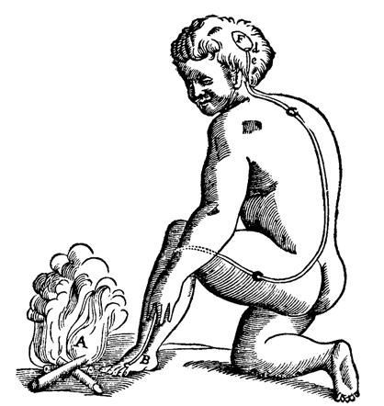
Cartesian Theory of Pain (Descartes)
No BRAIN
No Pain
Notes:
READ: Descartes was the first to propose that the brain directed response to pain and behavioral output. No brain – No pain. For example, individuals with spina bifida who do not have an intact spinal cord will be insensate and will not be able to experience or report pain below the lesion.
Descartes also suggested reflexive and highly predictable responses to pain prevent further tissue damage.
READ: Pair up for this “Pair and share activity.”
Share a time when you cared for a patient whose report of pain seemed disproportionate to observed tissue damage and your expectations. [Limit discussion to 5 minutes]
READ: Descartes proposed that the intensity of pain is directly related to the severity of tissue damage. This remains a commonly held assumption about pain. This may explain why chronic pain and patients whose reported pain intensity seems to be disproportionate to their level of injury are often the most challenging to treat.
[10 minutes of 30 minute session is complete]
© 2017 Manworren & Lurie Children’s Hospital
All rights reserved. Version 2019

Slide 4
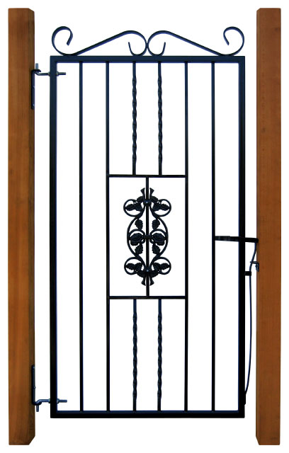
Gate Control Theory
The Pain Gate
PAINFUL stimulus | A-delta and C fibers | OPEN | ➔ Transmission of pain
Nonpainful stimulus | A-beta fibers | CLOSE
Notes:
ASK: Who can tell us how the gate theory helps to explain the mechanism of action of a pain treatment intervention?
Select participants willing to share their answers to this question.
[Limit discussion to 4 minutes]
READ: these Key points (if not included by participants):
A Delta fibers are large in diameter, but thinly myelinated, nerve fibers that are sensitive to mechanical and thermal stimuli and quick conductors. A delta fibers transmit the “first pain” which is typically sharp and localized.
Both A beta-fibers and C-fibers synapse onto cells in the substantia gelatinosa (SG) . A beta-fibers close the gate, whereas C-fibers open the gate.
C Fibers are thin and unmyelinated. Thus they have a slower transmission and are responsible for the dull, aching visceral pain that is diffuse in nature
[15 minutes of 30 minute session is complete]
© 2017 Manworren & Lurie Children’s Hospital
All rights reserved. Version 2019

Slide 5
Multimodal Analgesia: Many Gates?
Reprinted from:
AORN Journal, Vol.101(3),307-318.
Manworren, RCB, Multimodal Pain Management and the Future of a Personalized Medicine Approach to Pain. Copyright (2015) with permission from Elsevier.
Notes:
ASK: Who can name an intervention you find effective for treating pain; but is not on this diagram?
Select participants willing to share their answer to this question.
Write on flipchart or whiteboard
[Limit discussion to 2 minutes]
READ: these Key points (if not included by participants):
Research clearly shows that many factors influence pain perception.
Pain is not simply a neurophysiological phenomenon or the opening and closing of electrochemical gates.
© 2017 Manworren & Lurie Children’s Hospital
All rights reserved. Version 2019

Slide 6
Questions
How do the interventions listed that DO NOT have a mechanism of action work?
?
Notes:
ASK: What are the mechanisms of action for healing touch, heat, cold (which does NOT reduce swelling or pain!) and aromatherapy?
Select at least 2 participants willing to share their answers to this question.
[Limit discussion to 5 minutes]
READ: these Key points (if not included by participants):
Perhaps the mechanism is the social cultural aspects of interventions – like kissing your toddler’s scraped knee or even the site of a fall without injury.
Research clearly shows that many factors influence pain perception, but research has not yet given us all the answers.
[25 minutes of 30 minute session is complete]
© 2017 Manworren & Lurie Children’s Hospital
All rights reserved. Version 2019

Slide 7
Biopsychosocial Model of Pain
Biological Factors
Sociocultural Factors
Psychological Factors
Tissue damage
Genetic factors
Physiological mechanisms of pain
Ethnicity
Family history
Cultural factors
Negative mood (anger, anxiety, depression)
Coping strategies
Social learning
Notes:
READ: The biopsychosocial theory of pain is our current understanding of how we know an experience is pain and it is the foundational theory for this Pediatric PRN curriculum
The sensory stimulus is associated with tissue damage, but social aspects explain how children react to pain.
Culture sets boundaries for how children experience, respond to, and describe pain.
Psychological factors like personality, mood, and learned behaviors such as coping strategies can also influence how children experience pain and its impact on quality of life.
Mechanisms of action for treatments will be emphasized but sociocultural factors such as ethnicity, culture, and family history and psychological factors such as mood, coping strategies and social learning will also be discussed.
ASK: Are there any questions?
. Session ends when 30 minutes of session have elapsed.
© 2017 Manworren & Lurie Children’s Hospital
All rights reserved. Version 2019

